Slide 1
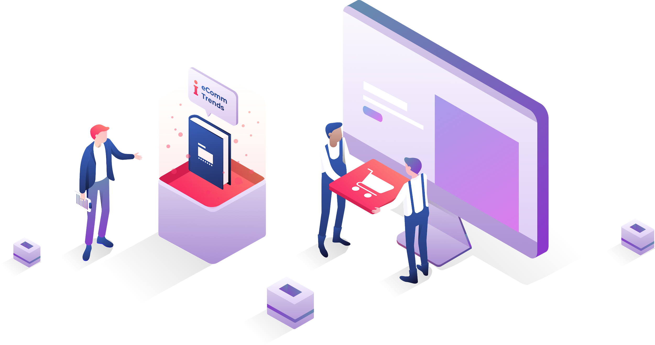
Your Logo
How eCommerce Trends for 2020 Will Affect Your Website

Slide 2
Your Agency Name
Your Logo
A description of your agency

Slide 3
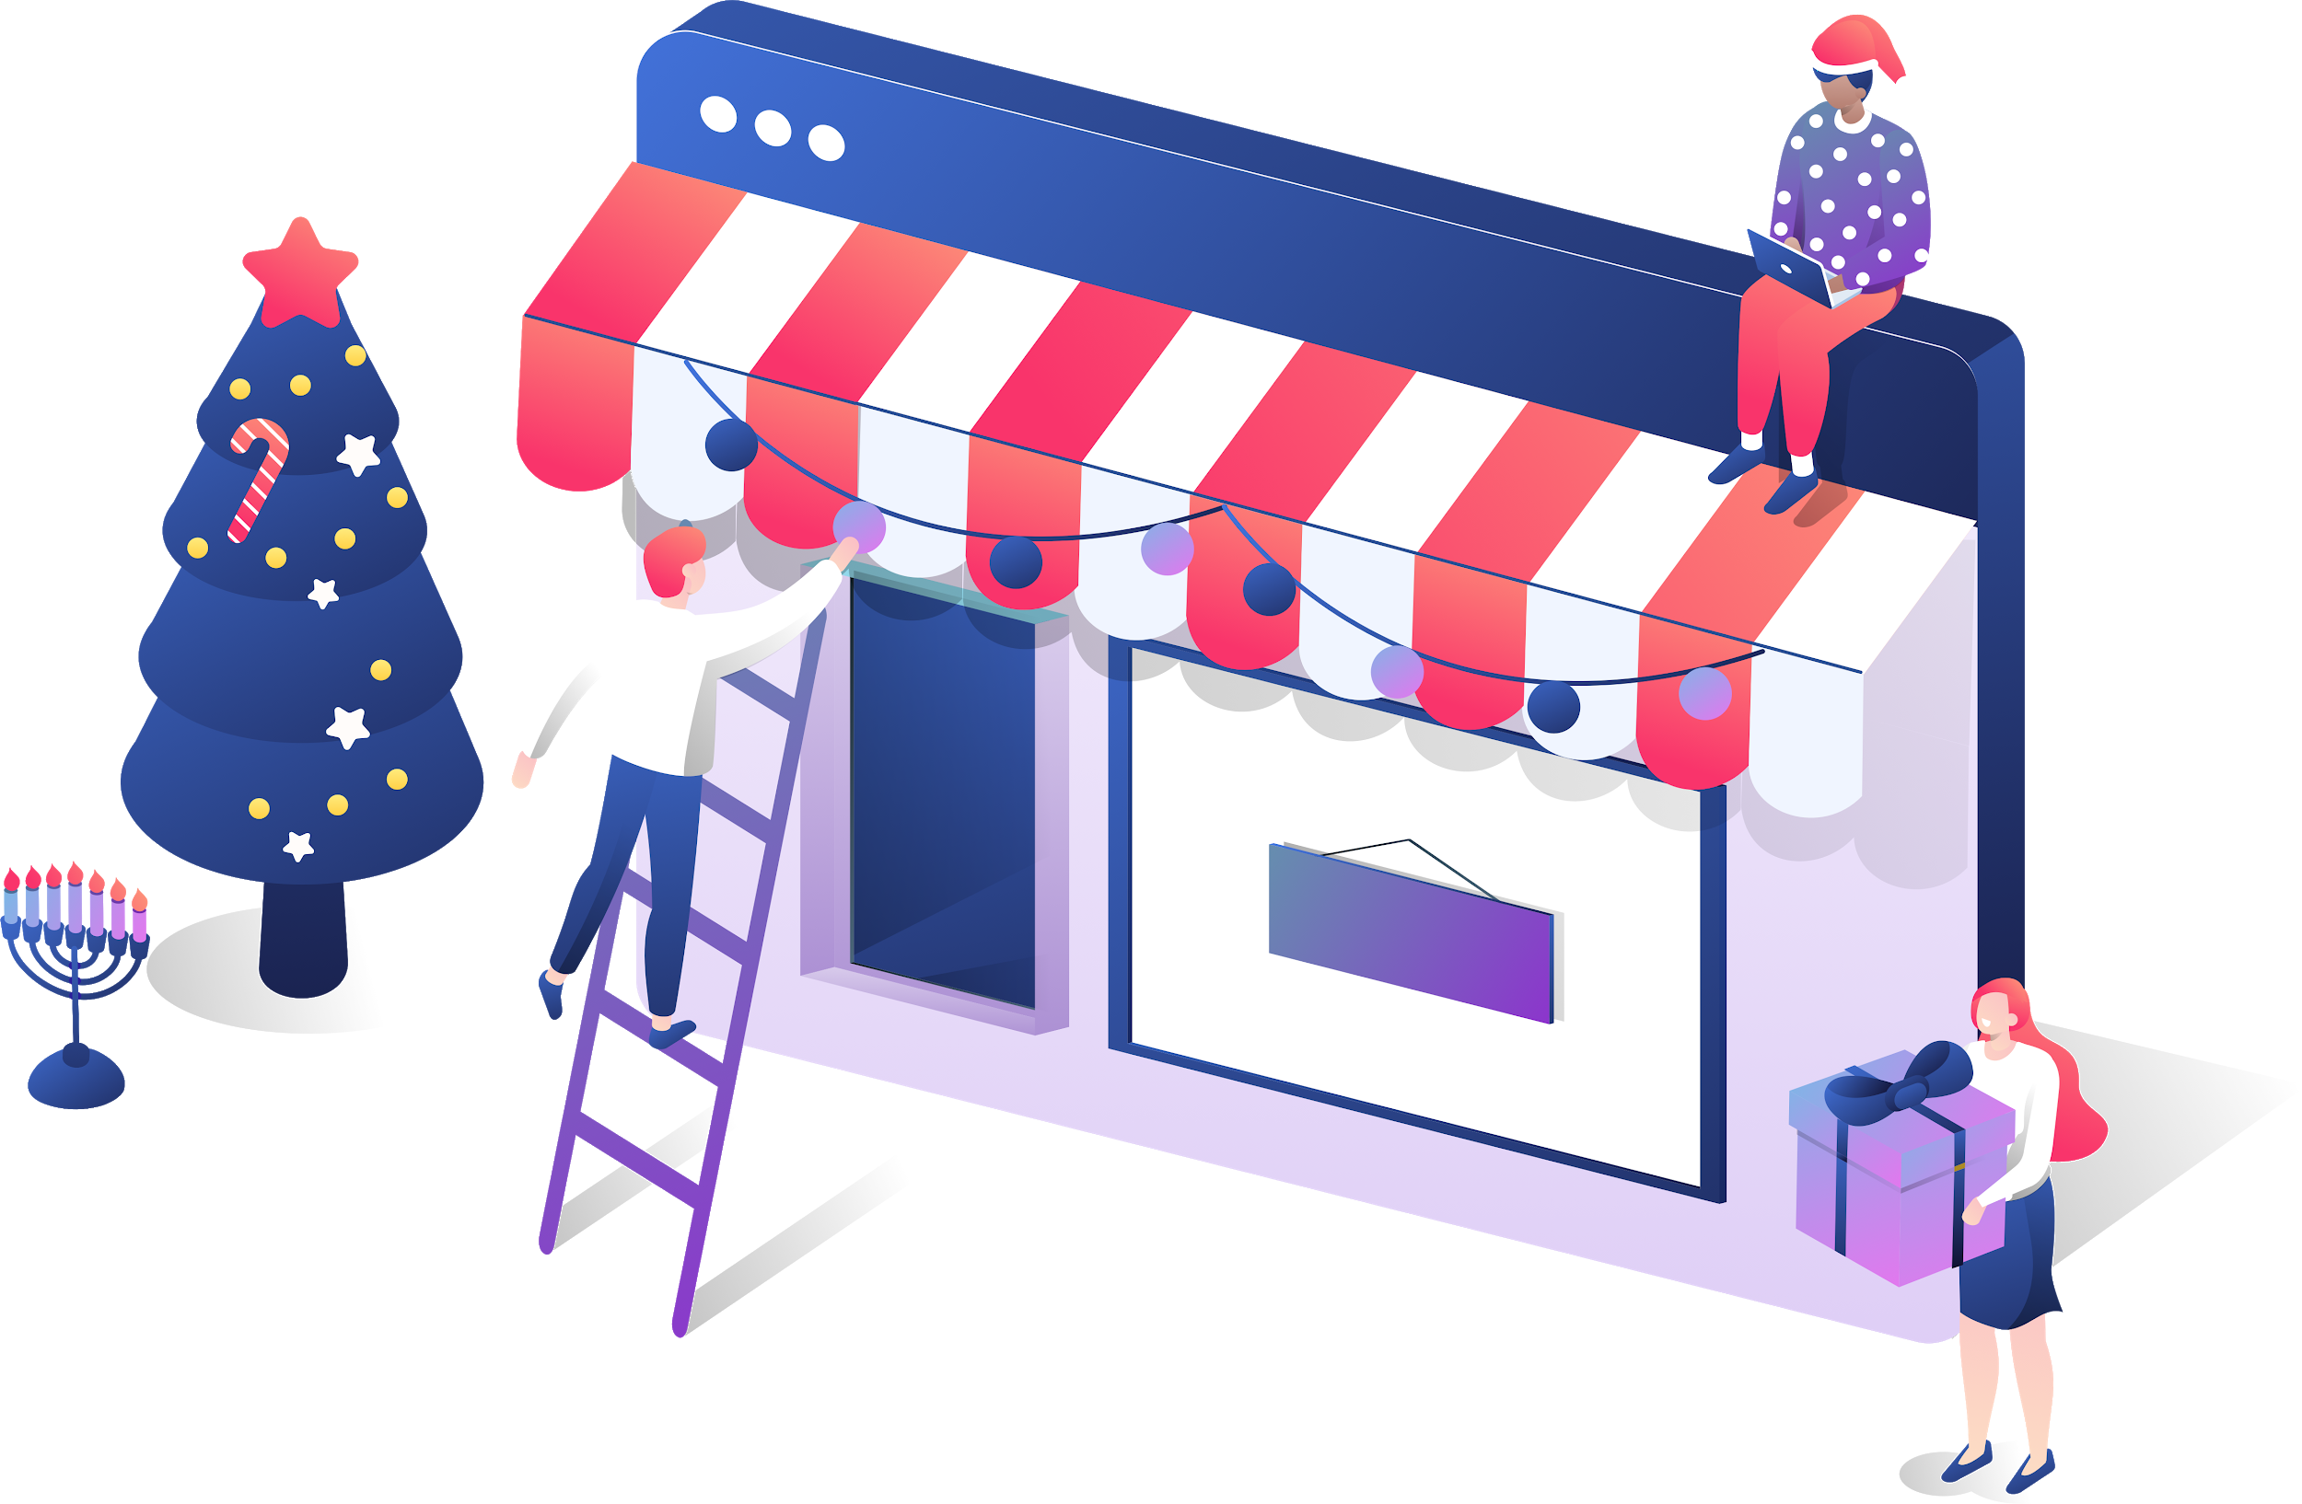
2020’s Holiday Season Will Be Unlike Any Year We’ve Ever Seen
Your Logo
As you get your business ready for the holidays, here are a number of online trends we are seeing that will have a dramatic effect on eCommerce and overall retail sales this year.

Slide 4

85% of Retailers Think Online Shopping Will Increase This Year
Your Logo
85% of industry professionals predict that eCommerce will increase this holiday season.
Accordingly, 55% of respondents are planning on increasing their investment in eCommerce technology this holiday season.
As more shopping moves online and the repercussions of the pandemic continue to disrupt traditional business models, savvy entrepreneurs are doubling down on eCommerce capabilities to capture more share from their less-agile competitors.
Source: BazaarVoice, https://www.bazaarvoice.com/press/2020-holiday-predictions/

Slide 5

71% of adults will do more than half their shopping online
Your Logo
All demographics, from Gen Z to Millennials to Gen X and Boomers, are planning on doing more than half their holiday shopping online.
Consumers of all ages will be shopping from their tablets and mobile phones as they are sitting on their couches, possibly while binge watching Netflix.
Businesses need to have their websites prepared for this surge, and need to make sure their sites are up to date, fast, and accessible.
Source: eMarketer, https://www.emarketer.com/content/majority-of-us-shoppers-will-turn-digital-holiday-shopping-needs-this-year

Slide 6
Holiday shopping will start to ramp in October this year
Your Logo
The online sales ramp will likely start in October, instead of late November this year.
Amazon is rumored to be shifting their “Prime Day” online sales to early October for 2020, which will likely kick off the online holiday rush.
Additionally, eCommerce purchasers are going to build more time in their schedules to allow for possible shipping delays.
You need to get your website ready now or risk missing the 2020 eCommerce shopping season.
Source: DigitalTrends,
https://www.digitaltrends.com/dtdeals/best-amazon-prime-day-deals/

Slide 7
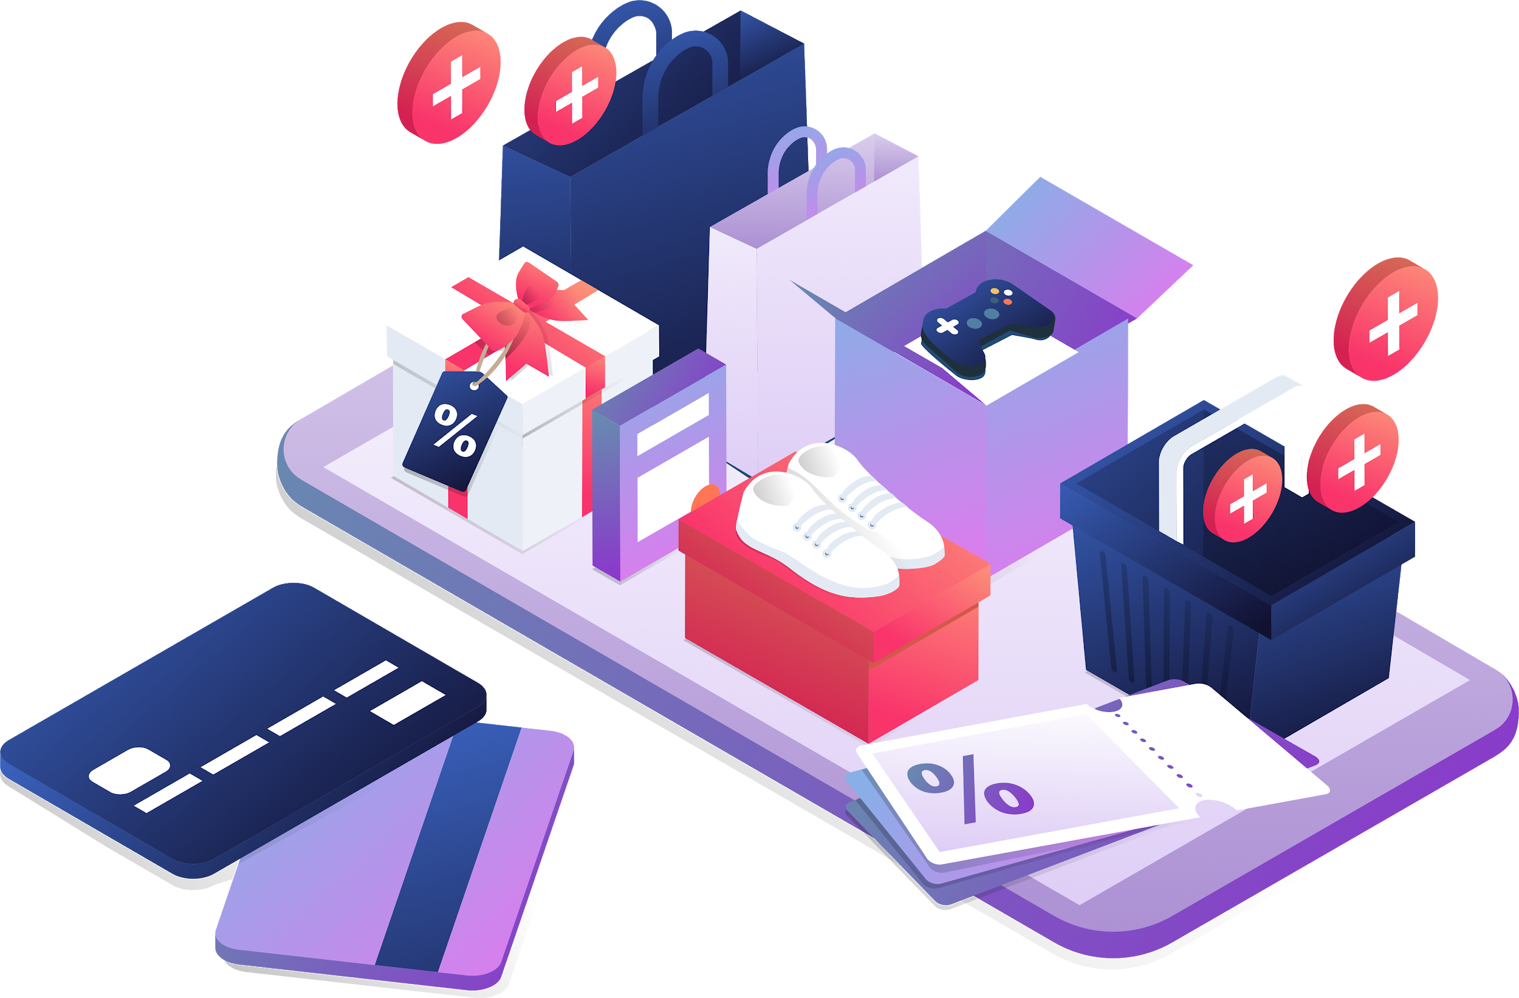
“Black Friday” will look very different for 2020
Your Logo
The COVID concerns around large crowds will significantly change the “doorbuster” sales from years past, as more commerce moves online.
Additionally, over 80 major retailers including Target, Wal-Mart, and others are significantly changing their Black Friday approach. They are closing stores on the U.S. Thanksgiving holiday, and generally modifying their take on this significant shopping day.
Independent businesses have an opportunity to fill niches historically occupied by big box retailers.
Source: Mashable, https://mashable.com/shopping/black-friday-2020-future-predictions/
Source: TheBlackFriday https://www.theblackfriday.com/stores-closed-on-thanksgiving-day.php

Slide 8

“Click and collect” eCommerce pickup is projected to grow 60.4% over last year
Your Logo
Compared to 2019, “click and collect” eCommerce orders, where a shopper orders an item online and then picks the item up at the physical retailer, is projected to grow 60.4% this year, according to eMarketer.
Click-and-collect sits at the intersection of three major benefits for customers in the time of COVID-19. It combines the convenience of ordering online, the immediacy of same-day pickup, and the inherent social distancing benefits of curbside pickup vs. having to spend an extended period of time shopping inside a brick-and-mortar store.
Source: eMarketer, https://www.emarketer.com/content/majority-of-us-shoppers-will-turn-digital-holiday-shopping-needs-this-year

Slide 9
More “buying” and less “browsing” in physical stores means more browsing will take place online
Your Logo
Brick-and-mortar stores will need to reconfigure their physical store layouts to support social distancing and will need to minimize or eliminate the amount of time customers spend inside their locations. As a result, more of the “browsing” activity that historically took place inside retail establishments will move online.
Successful holiday merchandising in 2020 will move from in-store displays to dynamic, personalized websites where visitors can browse and discover the items that are most likely to be part of their holiday shopping lists.
Source: Inc. , https://www.inc.com/anna-meyer/holiday-retail-shopping-trends-2020.html

Slide 10
Fewer big parties, more small gatherings
Your Logo
Big, blowout corporate holiday parties, if they happen at all, are going to be few and far between in 2020. Similarly, massive in-home holiday get togethers are going to give way to smaller, more personal gatherings with trusted friends and family.
eCommerce players who can provide and deliver special, meaningful gifts and experiences appropriate for smaller groups will have the advantage over those tailored for the larger holiday gatherings that were typical in past years.
Source: Inc., https://www.inc.com/anna-meyer/holiday-retail-shopping-trends-2020.html

Slide 11

Prepare to ship more holiday items directly to consumers
Your Logo
More eCommerce means more shipping of items, as consumers expect the convenience of having purchases delivered to their door, or delivered directly to their friends and family.
Make sure processes are in place to handle the shipping rush, prepare for longer shipping times as the demand on parcel delivery providers increases, and set customers’ expectations for shipping times given these circumstances.
No one likes gifts to be late, so set ordering cutoff dates accordingly.
Source: Inc., https://www.inc.com/anna-meyer/holiday-retail-shopping-trends-2020.html

Slide 12
Expect more online returns compared to past years
Your Logo
Along with an increase in online ordering and shipping, expect eCommerce returns to increase as well.
Update your website to clearly state your returns policy and procedures. This helps deflect inquiries and gives purchasers peace of mind before they click. Similarly, update product descriptions and photographs to help buyers understand exactly what they are getting.
Processes for refunding payments and handling return shipments should be tested prior to the holiday rush.
Source: Inc., https://www.inc.com/anna-meyer/holiday-retail-shopping-trends-2020.html

Slide 13
How eCommerce Trends for 2020 Will Affect Your Website
Your Logo
Your Name | youremail@youremail.com | Your site | +123 456 7890

